Slide 1
Three Books – Three Authors
Insurance Solvency Regulation Seminar
Stockholm, 14 November 2019
The information contained in this presentation is of a general nature and neither can nor should be construed as a substitute for legal advice in relation to an individual matter.
The General Terms and Conditions applicable to our services are available at vinge.se

Slide 2
Why did I write this book?
I wanted to write a practical solvency regulatory manual compatible with Swedish legal tradition and Swedish supervisory practices:
A basis for cooperation and understanding between lawyers and actuaries
A map for navigating the most extensive insurance regulation to date
A tool for understanding and interpreting an extremely complex and often conflicting and overlapping regulation

Slide 3
When did solvency become an issue for Swedish lawyers?
1999 – A sigh of relief
GENERAL MEETING
CORPORATE BODIES
AUDITOR
BOARD
CEO
ACTUARY
”The Board and the Auditor are often totally dependent on the specialist competence of the actuary”

Slide 4
When did solvency become an issue for Swedish lawyers?
2010 – Were the implications understood?
”There are other important areas of an insurance business that are not subject to special legal treatment …..
….. As in any other business, the liability for the business of the insurance company shall be carried by the Board and the CEO”
GENERAL MEETING
CORPORATE BODIES
AUDITOR
BOARD
CEO
ACTUARY
FUNCTIONS
UNDERWRITING
ASSET MANAGEMENT
LEGAL
IT
ACTUARY

Slide 5
When did solvency become an issue for Swedish lawyers?
1 January 2016 – An epiphany moment ?
RISK MANAGEMENT FUNCTION
GENERAL MEETING
CORPORATE BODIES
KEY FUNCTIONS
COMPLIANCE FUNCTION
AUDITOR
BOARD
INTERNAL AUDIT FUNCTION
CEO
ACTUARY
ACTUARIAL FUNCTION
FUNCTIONS
UNDERWRITING
ASSET MANAGEMENT
LEGAL
IT
ACTUARY

Slide 6
PROBLEM No 1
Simplified (sic!) calculation for spread risk on bonds and loans
SOLUTION
Arne Sandström, Handbook of Solvency for Actuaries and Risk Managers (p. 488)

Slide 7
PROBLEM No 2
SOLUTION
Framework Directive 276 pages
Delegated Act 797 pages
Implementing Technical Standards 2 104 pages
EIOPA Guidelines 479 pages
Swedish Insurance Business Act 104 pages
Swedish Supervisory Regulations 263 pages
TOTAL 4 023 pages
CEIOPS’ Advice Level 1 22 Advice
CEIOPS’ Advice Level 2 51 Advice
EIOPA’s Submissions Level 2 16 Submissions
EIOPA’s Final Reports Level 2,5 18 Final Reports
EIOPA’s Final Reports Level 3 29 Final Reports
TOTAL 136 preparatory works
DON’T PANIC !

Slide 8
PROBLEM No 3
The Swedish Council on Legislation
“When a Directive is to be implemented, it is reasonable to expect the Swedish legislator to be able to assess the purpose of the directive and to draft the law in accordance therewith …
… In summary, the proposed law is inadequate and unclear to the extent that it is unfit for legislation unless it is thoroughly redrafted”
Comment by the responsible Ministry of Finance official
”One must remember that Solvency II is a directive from hell and that it got even worse with Omnibus II”

Slide 9
SOLUTION - A positive attitude …
“Always look on the bright side of life”
Monty Python
“Solvency II is good for you”
Karel van Hulle

Slide 10
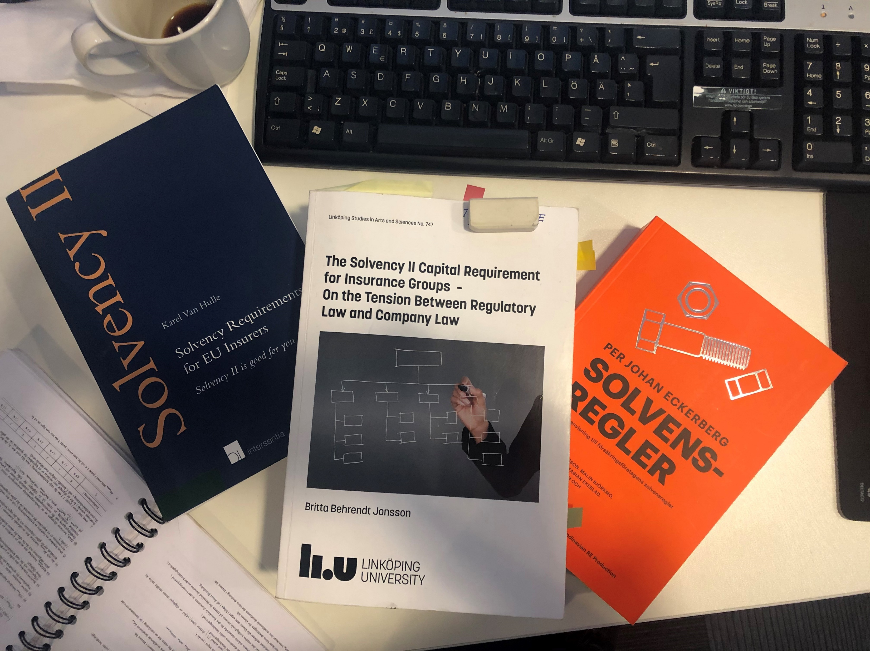
… and some helpful advice

